Slide 1
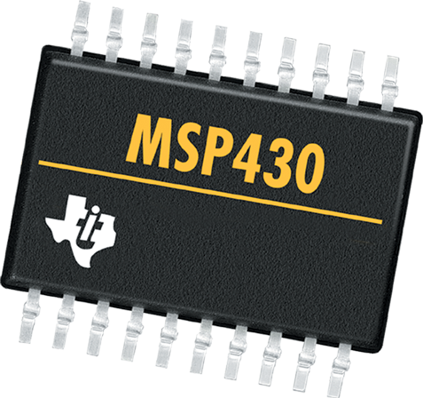
LAB 6: Serial Communication
CS 4101 Introduction to Embedded Systems
Chung-Ta King
National Tsing Hua University

Slide 2
Introduction
In this lab, we will learn
  Communication peripherals of MSP430 LaunchPad
  How to implement a software UART on MSP430 LaunchPad
  How to let MSP430 LaunchPad communicate with the PC through RS232 interface

Slide 3
Comm. Peripherals in MSP430
Universal Serial Interface (USI):
  A lightweight module handles only synchronous communication: SPI and I2C
  Included in MSP430G2331
Universal Serial Comm. Interface (USCI):
  Handle almost all aspects of the communication
  Asynchronous channel, USCI_A: act as a universal asynchronous receiver/transmitter (UART) to support the usual RS-232 communication
  Synchronous channel, USCI_B: handle both SPI and I²C as either master or slave
  Included in MSP430G2553

Slide 4
Software UART on LaunchPad

Slide 5
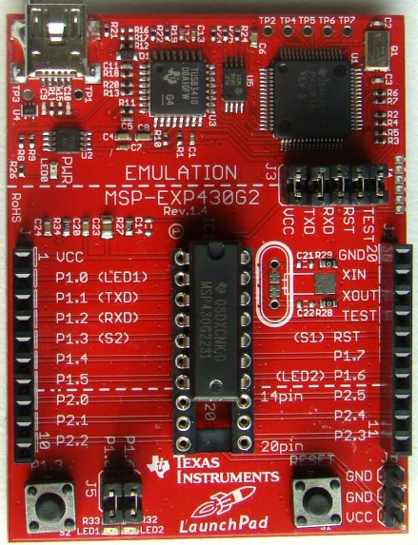
Recall
Pins for Comm
P1.1 → TXD
P1.2 → RXD

Slide 6
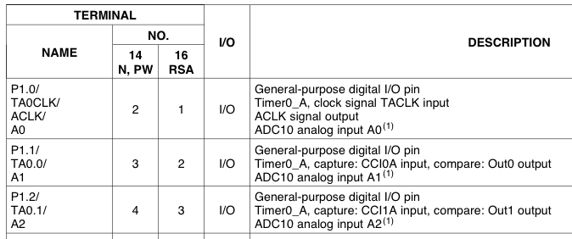
Pin Connections
Use TACCR0
TXD
Use TACCR1
RXD
#define TXD 0x02 // TXD on P1.1 (Timer0_A.OUT0) #define RXD 0x04 // RXD on P1.2 (Timer0_A.CCI1A) P1SEL |= TXD + RXD; // Enable TXD/RXD pins P1DIR = 0xFF & ~RXD; // Set pins to output P1OUT = 0x00; // Initialize all GPIO

Slide 7
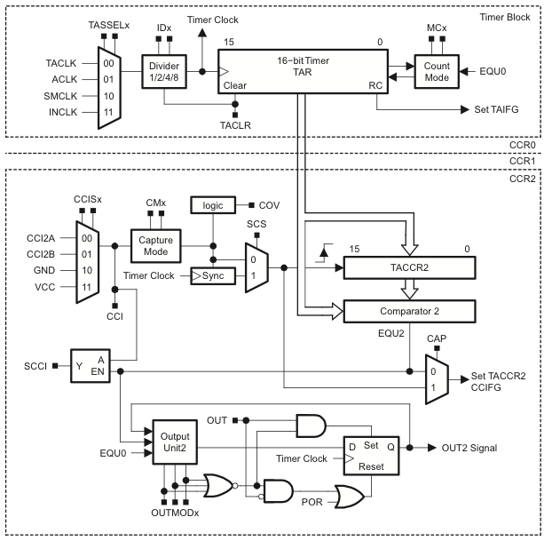
TXD
RXD
RXD pin
Latch allows sampling
at precise time,
regardless of ISR
latency
TXD pin

Slide 8
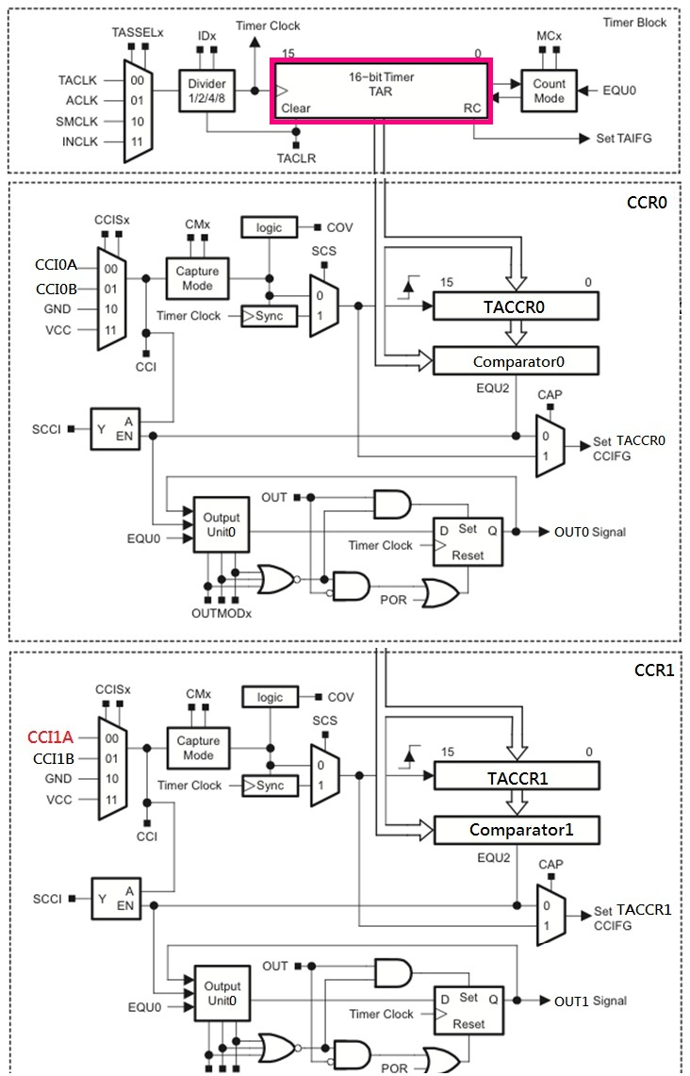
For
Transmission
TXD pin
For
Receive
RXD pin
Latch allows sampling
at precise time,
regardless of ISR
latency

Slide 9
Software UART by Timer_A
Between transmissions, CCx (capture/compare) waits in the Capture mode for a falling edge on its input.
When a falling edge is detected, TACCRx captures the count in TAR and an interrupt is requested. CCx is switched to Compare mode, and TACCRx is set to fire an interrupt after 1.5 of the bit period from now.
The next interrupt occurs and SCCI contains the value of LSB. ISR saves it. Next compare event is set up to occur after a further bit period.
The above procedure is repeated until all 8 bits of data have been received.

Slide 10
Software UART: Transmission
Use Capture/Compare Block 0 (TACCR0)
OUTMOD0: OUT0 signal is defined by OUT bit
OUTMOD2: OUT0 signal is reset when the timer counts to TACCR0
→ Use OUTMOD0 to send a 1, OUTMOD2 for 0
OUT0
Notes:
The OUTMODX determines how the signal changes when a CCR0 event happens.

Slide 11
Software UART: Transmission
#pragma vector = TIMER0_A0_VECTOR __interrupt void Timer_A0_ISR(void) { static unsigned char txBitCnt = 10; TACCR0 += UART_TBIT; // Add Offset to TACCR0 if (txBitCnt == 0) { // All bits TXed? TACCTL0 &= ~CCIE; // All bits TXed, disable int txBitCnt = 10; // Re-load bit counter } else { if (txData & 0x01) { // Check next bit to TX TACCTL0 &= ~OUTMOD2; // TX Mark '1’ } else { TACCTL0 |= OUTMOD2; } // TX Space '0' txData >>= 1; txBitCnt--; } }
Notes:
CCTL0 = OUT;
...
CCTL0 = CCIS0 + OUTMOD0 + CCIE; // Set signal, intial value, enable interrupts
...
CCTL0 &= ~ OUTMOD2; // TX Mark`
The three lines above go together, they all handle how the output pin is set. The OUTMODX determines how the signal changes when a CCR0 event happens. We should already be familiar with OUTMOD7 (Set/Reset). When OUTMOD0 is selected, the output signal will be set to whatever value the OUT bit in CCTL0 is set to. The first line above sets this bit to 1, so the output pin will be changed to 1. When OUTMOD2 is set, whenever a CCR0 event happens the output is cleared (set to 0). You can see this in the timer interrupt function, if the bit to be sent is equal to one, OUTMOD0 is set otherwise OUTMOD2 is set. This is a fancy way of saying set the output to 1 when the bit being sent is 1, and set the output to 0 when the bit being sent is 0.
Check: http://www.msp430launchpad.com/2010_07_01_archive.html

Slide 12
Software UART: Transmission
Initialization and preparing the byte to TX
... TACCTL0 = OUT; // Set to output high ... TACCR0 = TAR; // Current count of TA TACCR0 += UART_TBIT; // One bit time TACCTL0 = OUTMOD0 + CCIE; // Set TXD txData |= 0x100; // Add stop bit to TXData txData <<= 1; // Add start bit ...

Slide 13
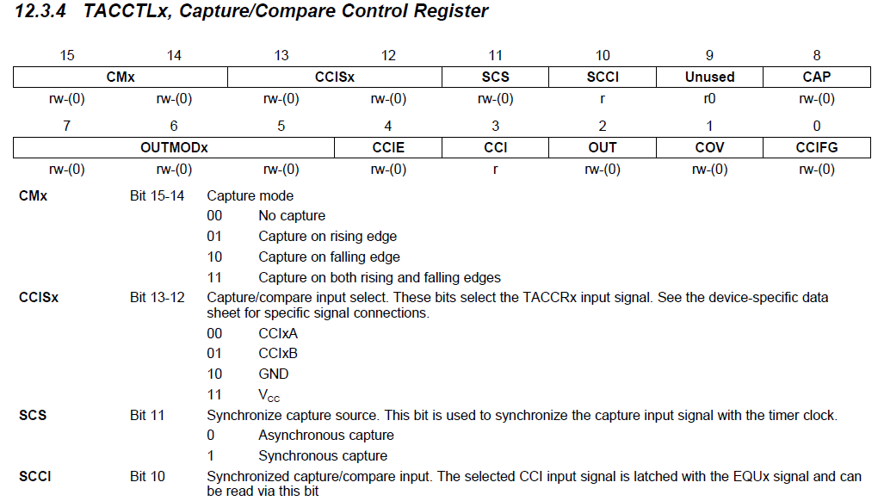
TACCTLx

Slide 14
Software UART: Receive
Initialization of Capture/Compare Block 1
TACCTL1 = SCS + CM1 + CAP + CCIE; // Sync, capture on neg edge, Capture mode // CCIS1 = 0 (default) → CCI1A, interrupt
P1.2

Slide 15
Software UART: Receive
#pragma vector = TIMER0_A1_VECTOR __interrupt void Timer_A1_ISR(void) { static unsigned char rxBitCnt = 8; TACCR1 += UART_TBIT; // Add offset to TACCR1 if (TACCTL1 & CAP) { // On start bit edge TACCTL1 &= ~CAP; // Switch to compare mode TACCR1 += UART_TBIT_DIV_2; // To middle of bit } else { // Sample the next data bit rxData >>= 1; if (TACCTL1 & SCCI){// Get bit from receive latch rxData |= 0x80; } rxBitCnt--; if (rxBitCnt == 0) { // All bits RXed? TACCTL1 |= CAP; } // Switch to capture mode }
Notes:
15
15

Slide 16
Sample Code (msp430g2xx3_ta_uart9600)
Software UART, using Timer_A, 9600 baud, echo, full duplex, 32kHz ACLK
  Main loop readies UART to receive one character and waits in LPM3 with all activity interrupt driven.
  ACLK = TACLK = LFXT1 = 32768Hz, MCLK = SMCLK = default DCO, external watch crystal required
  TACCR0 and TACCR1 may interrupt at any time and in an interleaved way

Slide 17
Sample Code (msp430g2xx3_ta_uart9600)
#include "msp430g2553.h“ #define UART_TXD 0x02 // TXD on P1.1 (Timer0_A.OUT0) #define UART_RXD 0x04 // RXD on P1.2 (Timer0_A.CCI1A) #define UART_TBIT_DIV_2 (1000000 / (9600 * 2)) #define UART_TBIT (1000000 / 9600) unsigned int txData; // UART internal TX variable unsigned char rxBuffer; // Received UART character void TimerA_UART_init(void); void TimerA_UART_tx(unsigned char byte); void TimerA_UART_print(char *string);
Notes:
17
17

Slide 18
Sample Code (msp430g2xx3_ta_uart9600)
void main(void) { WDTCTL = WDTPW + WDTHOLD; // Stop watchdog timer DCOCTL = 0x00; // Set DCOCLK to 1MHz BCSCTL1 = CALBC1_1MHZ; DCOCTL = CALDCO_1MHZ; P1OUT = 0x00; // Initialize all GPIO P1SEL = UART_TXD + UART_RXD; // Use TXD/RXD pins P1DIR = 0xFF & ~UART_RXD; // Set pins to output __enable_interrupt();
Notes:
18
18

Slide 19
Sample Code (msp430g2xx3_ta_uart9600)
TimerA_UART_init(); // Start Timer_A UART TimerA_UART_print("G2xx2 TimerA UART\r\n"); TimerA_UART_print("READY.\r\n"); for (;;) { // Wait for incoming character __bis_SR_register(LPM0_bits); // Echo received character TimerA_UART_tx(rxBuffer); } } void TimerA_UART_print(char *string) { while (*string) TimerA_UART_tx(*string++); }
Waken up by
Timer_A1_ISR
Notes:
19
19

Slide 20
Sample Code (msp430g2xx3_ta_uart9600)
void TimerA_UART_init(void) { TACCTL0 = OUT; // Set TXD Idle as Mark = '1' TACCTL1 = SCS + CM1 + CAP + CCIE; // Sync, Neg Edge, Capture, Int TACTL = TASSEL_2 + MC_2; // SMCLK, continuous mode } void TimerA_UART_tx(unsigned char byte) { while (TACCTL0 & CCIE); // Ensure last char TX'd TACCR0 = TAR; // Current state of TA counter TACCR0 += UART_TBIT; // One bit time till first bit TACCTL0 = OUTMOD0 + CCIE; // Set TXD on EQU0, Int txData = byte; // Load global variable txData |= 0x100; // Add mark stop bit to TXData txData <<= 1; // Add space start bit }
20
Notes:
20
20

Slide 21
Sample Code (msp430g2xx3_ta_uart9600)
#pragma vector = TIMER0_A0_VECTOR __interrupt void Timer_A0_ISR(void) { static unsigned char txBitCnt = 10; TACCR0 += UART_TBIT; // Add Offset to CCRx if (txBitCnt == 0) { // All bits TXed? TACCTL0 &= ~CCIE; // All bits TXed, disable int txBitCnt = 10; // Re-load bit counter } else { if (txData & 0x01) { TACCTL0 &= ~OUTMOD2; // TX Mark '1’ } else { TACCTL0 |= OUTMOD2;} // TX Space '0‘ txData >>= 1; txBitCnt--; } }
21
Notes:
21
21

Slide 22
Sample Code (msp430g2xx3_ta_uart9600)
#pragma vector = TIMER0_A1_VECTOR __interrupt void Timer_A1_ISR(void) { static unsigned char rxBitCnt = 8; static unsigned char rxData = 0; switch (__even_in_range(TA0IV, TA0IV_TAIFG)) { case TA0IV_TACCR1: // TACCR1 CCIFG - UART RX TACCR1 += UART_TBIT; // Add Offset to CCRx if (TACCTL1 & CAP) { // On start bit edge TACCTL1 &= ~CAP; // Switch to compare mode TACCR1 += UART_TBIT_DIV_2; // To middle of D0 } else { // Get next data bit rxData >>= 1;
22
Notes:
22
22

Slide 23
Sample Code (msp430g2xx3_ta_uart9600)
if (TACCTL1 & SCCI) { // Get bit from latch rxData |= 0x80; } rxBitCnt--; if (rxBitCnt == 0) { // All bits RXed? rxBuffer = rxData; // Store in global rxBitCnt = 8; // Re-load bit counter TACCTL1 |= CAP; // Switch to capture __bic_SR_register_on_exit(LPM0_bits); // Clear LPM0 bits from 0(SR) } } break; } }
Wake up
main loop
23
Notes:
23
23

Slide 24
PC to LaunchPad via RS232

Slide 25
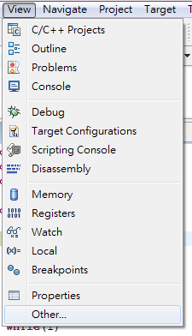
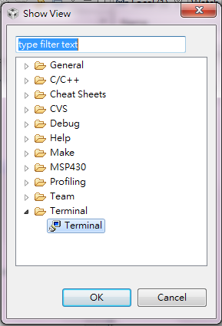
Setting PC for Serial Comm.
In the Debug perspective of CCS IDE, click [View] -> [Other…] and, in the Show View window, click the + next to Terminal.
Select Terminal below that and click OK.

Slide 26
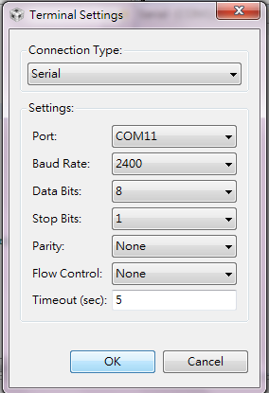
Setting PC for Serial Comm.
A Terminal pane will appear on your screen. Click the Settings button in the Terminal pane and make the selections (set the serial communication setting)

Slide 27
Basic Lab
Modify the full-duplex sample code to a half-duplex UART that receives characters 0 or 1 from the PC. Turn on the green LED if a 1 is received, the red LED if a 0 is received, and no LED for other characters. Use 4800 baud, 8-bit of data, and 2 stop bits.

Slide 28
Bonus
Temperature Sensing System
  MSP430 reads temperature from ADC every second and compare reading with the one sensed in previous second.
  If the current temperature is higher, turn on the red LED and send HI to PC
  If the current temperature is lower, turn on the green LED and send LO to PC
  If the sensed temperature is equal to the first one turn off both LEDs and send IN to PC
Hint:
  Use Timer_A alternatively for timing 1 sec and UART

Slide 29
Backup slides

Slide 30
Sample Code for USCI_A0
Echo a received character using 9600 UART and DCO-driven SMCLK running at 1MHz
  Use RX ISR
  USCI_A0 RX interrupt triggers TX Echo
  Baud rate divider with 1MHz = 1MHz/9600 = ~104.2

Slide 31
Sample Code for USCI_A0
#include "msp430g2553.h" void main(void) { WDTCTL = WDTPW + WDTHOLD; // Stop WDT BCSCTL1 = CALBC1_1MHZ; // Set DCO to 1MHz DCOCTL = CALDCO_1MHZ; P1SEL = BIT1 + BIT2 ; // P1.1 = RXD, P1.2=TXD P1SEL2 = BIT1 + BIT2 ; // P1.1 = RXD, P1.2=TXD UCA0CTL1 |= UCSSEL_2; // SMCLK UCA0BR0 = 104; // 1MHz 9600 UCA0BR1 = 0; // 1MHz 9600 UCA0MCTL = UCBRS0; // Modulation UCBRSx = 1 UCA0CTL1 &= ~UCSWRST; // Initialize USCI IE2 |= UCA0RXIE; // Enable USCI_A0 RX interrupt // Enter LPM0, interrupts enabled __bis_SR_register(LPM0_bits + GIE); }
31
Notes:
31
31

Slide 32
Sample Code for USCI_A0
// Echo back RXed character, // confirm TX buffer is ready first #pragma vector=USCIAB0RX_VECTOR __interrupt void USCI0RX_ISR(void) { // USCI_A0 TX buffer ready? while (!(IFG2&UCA0TXIFG)); UCA0TXBUF = UCA0RXBUF; // TX -> RXed character }
32
Notes:
32
32

Slide 33
Basic Lab
Emulate UART by Timer
  Fill up the sample code
  Send “Hello World” to the PC from MSP430 LanuchPad in the main loop
Hints
  TXByte can be seen as the data buffer, where we store the character we want to send. We use ASCII code.
  You need to set the Bit Time correctly.
  send[]={0x48,0x49,0x0A,0x08,0x08};
for (i=0;i<5;i++) {
TXByte = send[i];
Transmit();
}

