Slide 1
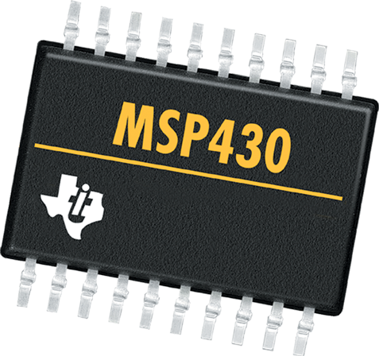
LAB 4: Interrupt
CS 4101 Introduction to Embedded Systems
Chung-Ta King
National Tsing Hua University

Slide 2
Introduction
In this lab, we will learn
The interrupt of Timer_A in MSP430
The interrupt of port P1 in MSP430
How to write an interrupt service routine

Slide 3
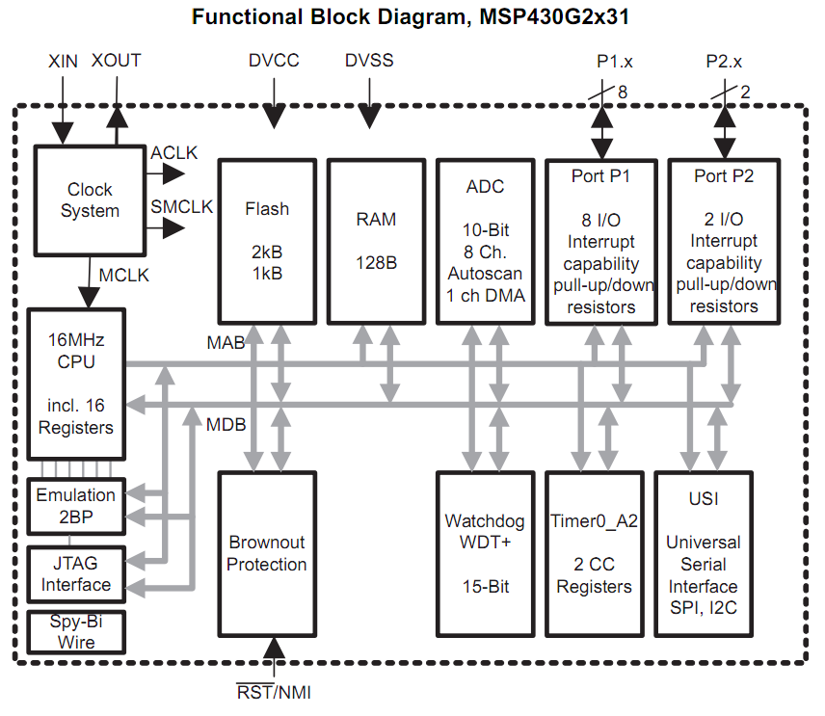
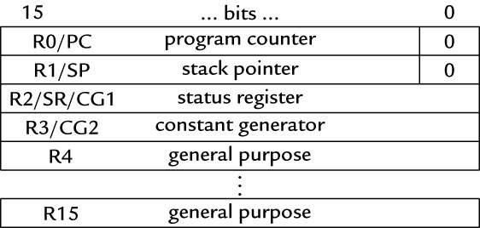
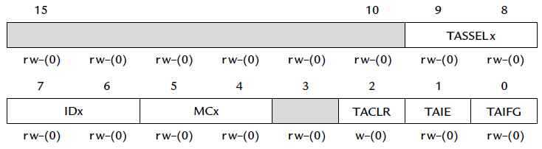
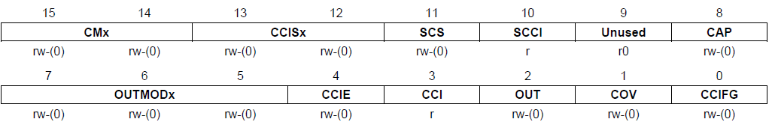
Enabling Interrupts in MSP430
P1IE
GIE
TAIE
TAIFG
TACTL
CCIE
CCIFG
(General Interrupt Enable)
TACCTL

Slide 4
3 Types of Interrupts in MSP430
System reset:
Power-up, external reset, Watchdog Timer, flash key violation, PC out-of-range, etc.
Always take
(Non)-maskable interrupt (NMI):
RST/NMI pin, oscillator fault, flash access violation
Cannot be masked by clearing the GIE bit; but still need bits to be set in special peripheral registers
Maskable interrupt

Slide 5
When an Interrupt Is Requested
Any currently executing instruction is completed
PC, pointing to next instruction, is pushed onto stack
SR is pushed onto the stack
The interrupt with the highest priority is selected
The interrupt request flag is cleared automatically for vectors that have a single source
SR is cleared, and maskable interrupts are disabled
The interrupt vector is loaded into the PC and the CPU starts to execute the ISR at that address
These operations take about 6 cycles

Slide 6
After an Interrupt Is Serviced
An interrupt service routine must always finish with the return from interrupt instruction reti:
The SR pops from the stack. All previous settings of GIE and the mode control bits are now in effect. → enable maskable interrupts and restore the previous low-power mode if there was one.
The PC pops from the stack and execution resumes at the point where it was interrupted. Alternatively, the CPU stops and the device reverts to its low-power mode before the interrupt.

Slide 7
Interrupt Vectors
The MSP430 uses vectored interrupts
The address (vector) of each ISR is stored in a vector table at a fixed memory location (0xFFC0–0xFFFF)
A vector is usually associated with a unique interrupt, but some sources share a vector and software (the ISR) must locate the source of interrupts
Each interrupt vector has a distinct priority, which is used to select which vector is taken if more than one interrupt is active. The priorities are fixed in hardware, given simply by the address of the vector

Slide 8
Interrupt Source | Interrupt Flag | System Interrupt | Word Address | Priority
Power-up/external reset/Watchdog Timer+/flash key viol./PC out-of-range | PORIFG RSTIFG WDTIFG KEYV | reset | 0FFFEh | 31 (highest)
NMI/Oscillator Fault/ Flash access viol. | NMIIFG/OFIFG/ ACCVIFG | non-maskable | 0FFFCh | 30
 |  |  | 0FFFAh | 29
 |  |  | 0FFF8h | 28
 |  |  | 0FFF6h | 27
Watchdog Timer+ | WDTIFG | maskable | 0FFF4h | 26
Timer_A | TACCR0 CCIFG | maskable | 0FFF2h | 25
Timer_A | TACCR1 CCIFG, TAIFG | maskable | 0FFF0h | 24
 |  |  | 0FFEEh | 23
 |  |  | 0FFECh | 22
ADC10 | ADC10IFG | maskable | 0FFEAh | 21
USI | USIIFG USISTTIFG | maskable | 0FFE8h | 20
I/O Port P2 (2) | P2IFG.6, P2IFG.7 | maskable | 0FFE6h | 19
I/O Port P1 (8) | P1IFG.0 to P1IFG.7 | maskable | 0FFE4h | 18
 |  |  | 0FFE2h | 17
 |  |  | 0FFE0h | 16
Unused |  |  | 0FFDEh 0FFCDh | 15 - 0
Notes:
The MSP430 uses vectored interrupts, which means that the address of each ISR—its vector—is stored in a vector table at a deﬁned address in memory. In most cases each vector is associated with a unique interrupt but some sources share a vector. The ISR itself must locate the source of interrupts that share vectors. For example, TAIFG shares a vector with the capture/compare interrupts for all channels of Timer_A other than 0. Channel 0 has its own interrupt ﬂag TACCR0 CCIFG and separate vector.
8

Slide 9
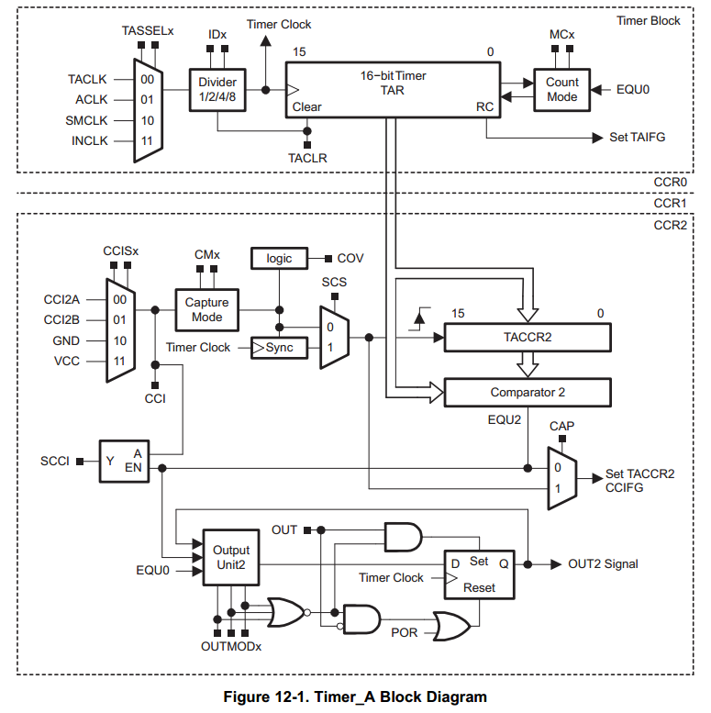
Interrupts from Timer_A
Interrupts can be generated by the timer itself (flag TAIFG) and each capture/compare block (flag TACCRn CCIFG)
TAIFG
CCIFG
TACTL
TACCTL

Slide 10
2 Interrupt Vectors for Timer_A
1. For TACCR0 CCIFG (high priority):
CCIFG0 flag is cleared automatically when serviced
2. For all other CCIFG flags and TAIFG
In compare mode, any CCIFG flag is set if TAR counts to the associated TACCRx value
Flags are not cleared automatically, because need to determine who made the interrupt request
Can use software (ISR) to poll the flags → slow
Use hardware: interrupt vector register (TAIV)

Slide 11
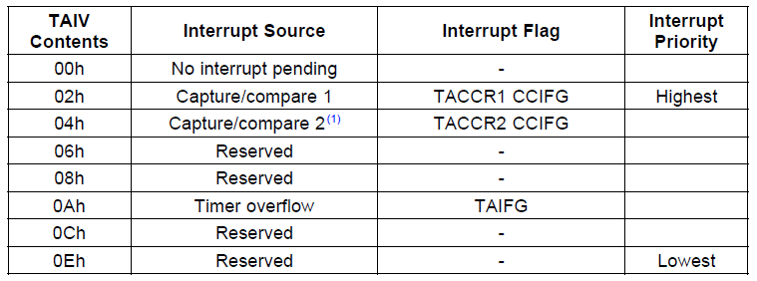
TAIV
On an interrupt, TAIV contains a number indicating highest priority enabled interrupt
Any access of TAIV resets the highest pending interrupt flag. If another interrupt flag is set, another interrupt is immediately generated

Slide 12
Sample Code for Timer_A
Toggle LEDs using interrupts from Timer_A in up mode
#include <io430x11x1.h> // Specific device #include <intrinsics.h> // Intrinsic functions #define LED1 BIT0 void main (void) { WDTCTL = WDTPW|WDTHOLD; // Stop watchdog timer P1OUT = ˜LED1; P1DIR = LED1; TACCR0 = 49999; // Upper limit of count for TAR TACCTL0 = CCIE; // Enable interrupts TACTL = MC_1|ID_3|TASSEL_2|TACLR; // Up mode, divide clock by 8, clock from SMCLK, clear __enable_interrupt(); // Enable interrupts (intrinsic) for (;;) { // Loop forever doing nothing } } // Interrupt service routine for Timer_A #pragma vector = TIMERA0_VECTOR __interrupt void TA0_ISR (void){ P1OUT ˆ= LED1; // Toggle LED }
Notes:
12
The code is for different device
12

Slide 13
Sample Code Explained
#pragma line associates the function with a particular interrupt vector
__interrupt keyword names the function
Compiler will generate code to store address of the function in the vector and to use reti rather than ret at the end of the function
An intrinsic function, __enable_interrupt() sets the GIE bit and turn on interrupts
It is declared in intrinsics.h

Slide 14
Interrupts on Digital Inputs
We have seen that port P1 has several registers associate with it
P1IN, P1OUT, P1DIR, P1REN
In fact, it has more registers; some are used for interrupts
Yes, ports P1 and P2 can request an interrupt when the value on an input pin changes!

Slide 15
Interrupts on Digital Inputs
Registers of P1 for interrupt:
Port P1 interrupt enable, P1IE: enables interrupts when the value on an input pin changes, by setting appropriate bits of P1IE to 1; off (0) by default
Port P1 interrupt edge select, P1IES: can generate interrupts either on a positive edge (0), when the input goes from low to high, or on a negative edge (1)

Slide 16
Interrupts on Digital Inputs
Registers of P1 for interrupt (cont’d):
Port P1 interrupt flag, P1IFG: a bit is set when the selected transition has been detected on the input, and an interrupt is requested if it has been enabled.
A single vector for the port
The user must check P1IFG to determine the bit that caused the interrupt.
This bit must be cleared explicitly

Slide 17
Sample Code for P1
A hi/low transition on P1.4 triggers P1_ISR to toggles P1.0
void main(void) { WDTCTL = WDTPW + WDTHOLD; // Stop watchdog timer P1DIR = 0x01; // P1.0 output, else input P1OUT = 0x10; // P1.4 set, else reset P1REN |= 0x10; // P1.4 pullup P1IE |= 0x10; // P1.4 interrupt enabled P1IES |= 0x10; // P1.4 Hi/lo edge P1IFG &= ~0x10; // P1.4 IFG cleared _BIS_SR(GIE); // Enter interrupt while(1); } // Port 1 interrupt service routine #pragma vector=PORT1_VECTOR __interrupt void Port_1(void) { P1OUT ^= 0x01; // P1.0 = toggle P1IFG &= ~0x10; // P1.4 IFG cleared }
Notes:
17
17

Slide 18
Sample Code
#include <msp430g2231.h> (#include <msp430g2553.h>) void ConfigWDT(void); void ConfigClocks(void); void ConfigLEDs(void); void ConfigTimerA2(void); void main(void) { ConfigWDT(); ConfigClocks(); ConfigLEDs(); // enable and turn off LED ConfigTimerA2(); _BIS_SR(GIE); // Turn on Interrupts // GIE: general iterrupt enable while(1) P1OUT |= BIT0; // turn on red LED }

Slide 19
Basic Lab
Complete the functions in the sample code.
Flash green LED at 1 Hz based on the interrupt from Timer_A, which is driven by SMCLK sourced by VLO.
Hint: For different devices, the "Interrupt Vectors name" may be different; plz check the header file for the correct Interrupt Vectors name.
While keeping the green LED flashing at 1 Hz, use polling to monitor the activity of the button. Pushing the button turns on the red LED and releasing the button turns it off.

Slide 20
Bonus
Write an ISR for the button , and whenever the button is pushed, make the blinking LED into red LED and vice versa.
Hint: PORT1_VECTOR as interrupt type, P1IFG as interrupt flag, P1IE to enable interrupt for port 1, BIT3 to represent the 3rd bit.

