Slide 1
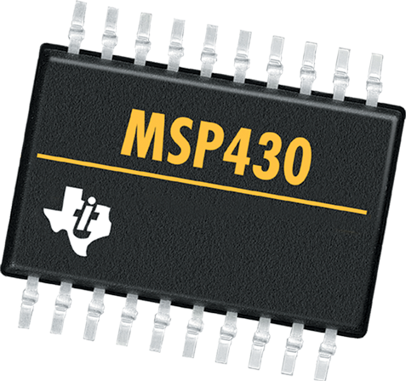
LAB 9: Environment Setup for Tower System
CS 4101 Introduction to Embedded Systems
Chung-Ta King
National Tsing Hua University

Slide 2
Introduction
In this lab, we will learn
To install the development environment and MQX
To set up Tower System and build MQX libraries
To develop and download program to Tower

Slide 3
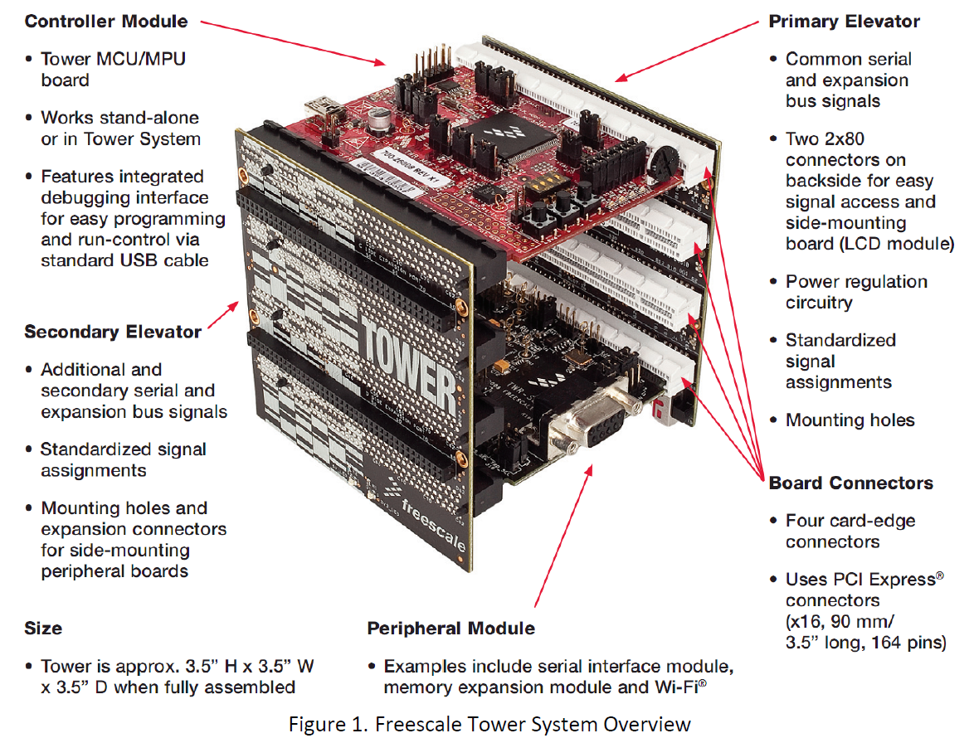
Tower System
You will get :
TWR-K60D100M MCU Module
TWR-ELEV
TWR-SER
TWR-MEM

Slide 4
Development Environment & RTOS
CodeWarrior Development Studio 10.2
MQX™ RTOS 3.8.0

Slide 5
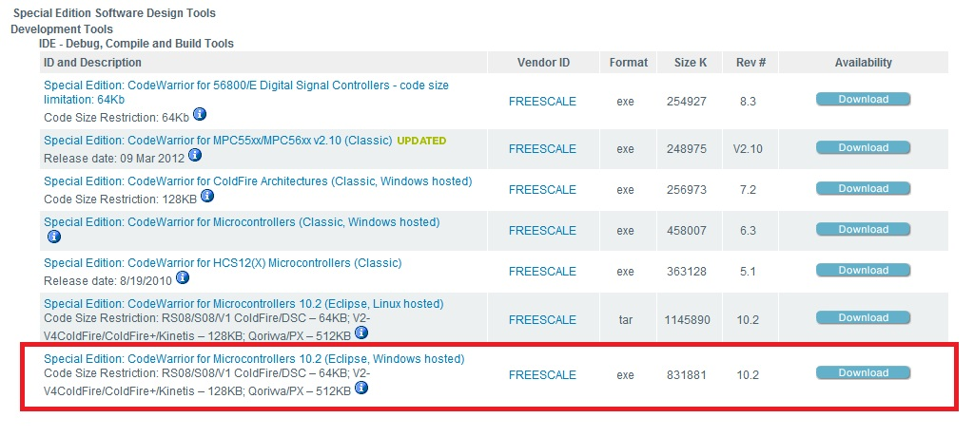
CodeWarrior Development Studio 10.2
Go to CodeWarrior for Microcontrollers10
(http://www.freescale.com/webapp/sps/site/overview.jsp?code=CW_SPECIALEDITIONS)
Select “Special Edition: CodeWarrior for Microcontrollers 10.2 (Eclipse, Windows hosted) ” in Getting Started section
You can download from the website or course ftp

Slide 6
MQX™ RTOS 3.8.0 TWR-K60D100M
Run the self-extracting K60D100M package installer and proceed according to instructions
The files will be installed directly into the specified folder in your PC

Slide 7
Simple Test

Slide 8
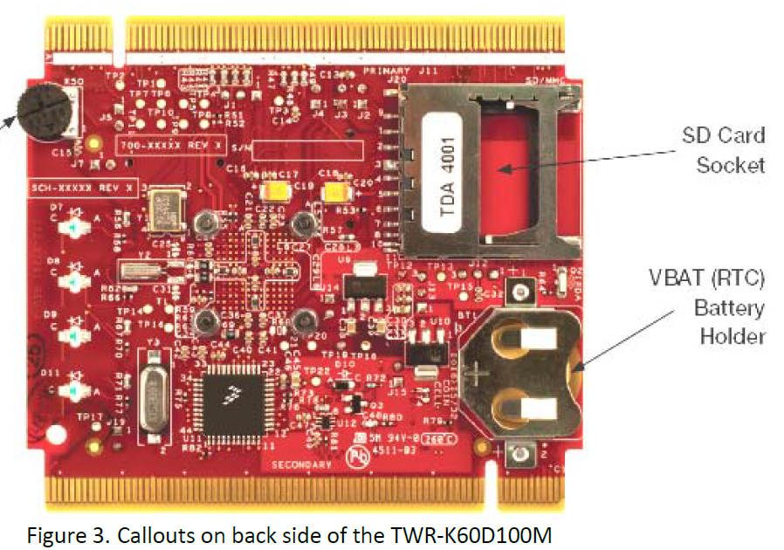
Configure the Hardware
Install the included battery into the VBAT(RTC) battery holder.
Connect one end of the USB cable to the PC and the other end to the power/OSJTAG mini-B connector on the TWR-K60D100M module.
Allow the PC to automatically configure USB drivers if needed

Slide 9
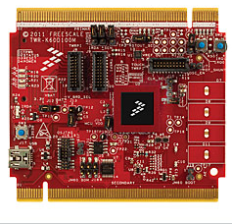
Tilt the Board
Tilt the board side to side to see the LEDs on D7,D8,D9 and D11 light up as it is tilted.
3-axis accelerometer demo
Hold the board flat, and touch the pads on D7, D8, D9, D11 to toggle the LEDs.
Touch pads
LEDs

Slide 10
Play the Memory Game
Press SW2 to play a memory recall game using the touch pads D7,D8,D9 and D11.
A sequence will light up, then press the touch pads in the order flashed.
If an incorrect sequence is pressed or too much time has elapsed, the LEDs will blink rapidly and the game will reset.
Press SW1 to return to the accelerometer demo.

Slide 11
Set up the Tower System and Build the MQX Libraries

Slide 12
Setting up the Tower System
Use a PC (host) to control and develop programs for the Tower System (target), and load files to the Tower System
Connect one end of the USB cable to the PC and the other end to the power/OSJTAG mini-B connector on the TWR-K60D100M module.
Connect one end of the USB cable to the PC and the other end to the mini-B connector on the Primary Elevator module.

Slide 13
Building the MQX Libraries
PSP (Processor support Package) and BSP (Board support Package) libraries must be built before building any application or changing kernel or I/O drivers

Slide 14
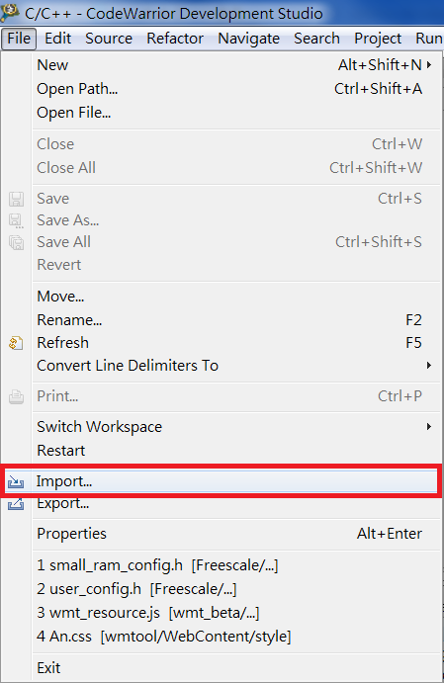
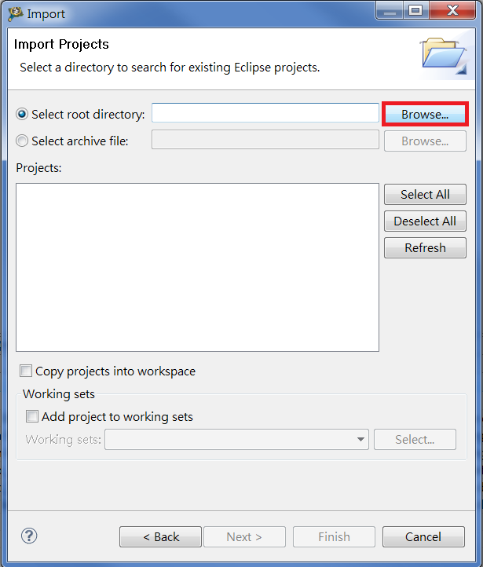
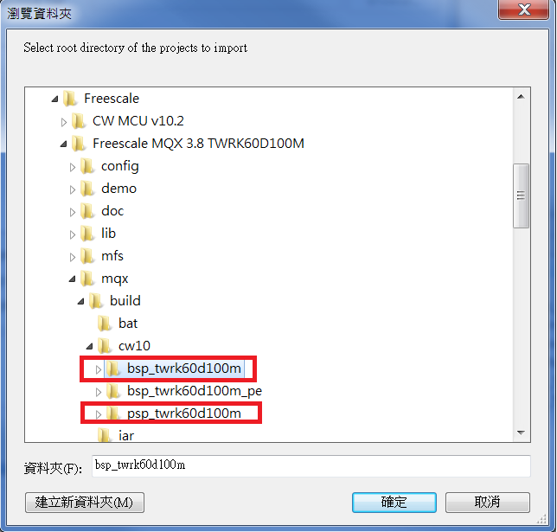
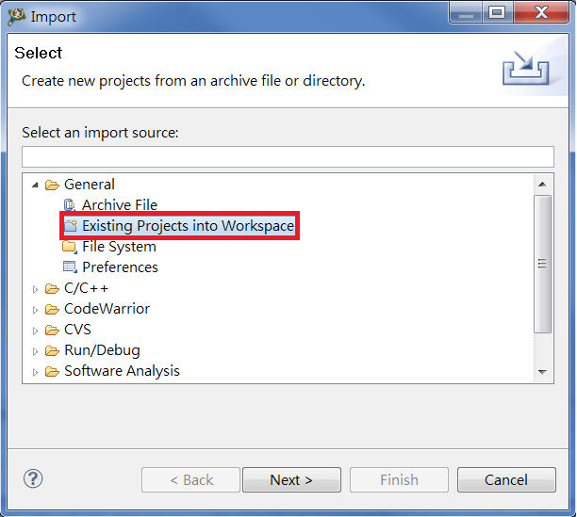
Import BSP and PSP files
Select menu File/Import/General/Existing Projects into Workspace and navigate to your MQX installation directory.
3
1
2
4
Freescale MQX 3.8 TWRK60D100M
mqx/build/cw10/
Warning : The "Copy projects into workspace" check box in the file importer must be unchecked. Leaving this option enabled will corrupt the project and the libraries will not be able to build.

Slide 15
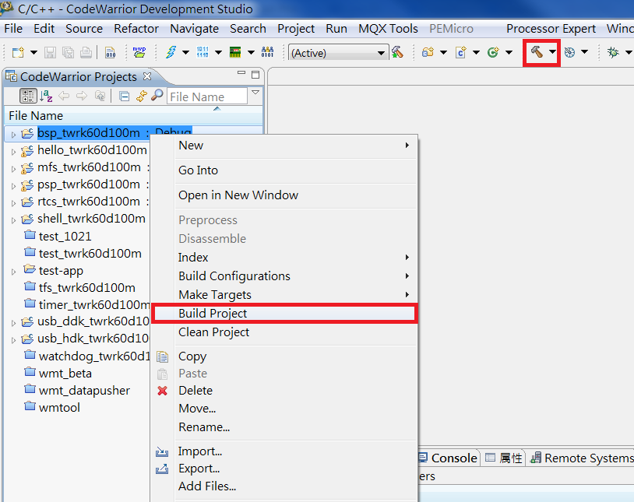
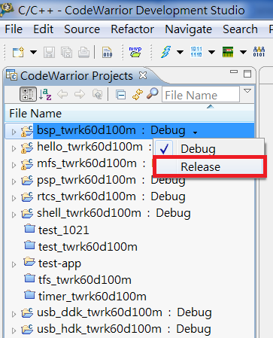
2. Use CodeWarrior to compile all MQX libraries
Build target (By default, the Debug build target is selected in all projects)
Switch all libraries to Release target and rebuild again
1
3
2
Build again ! (Release target)

Slide 16
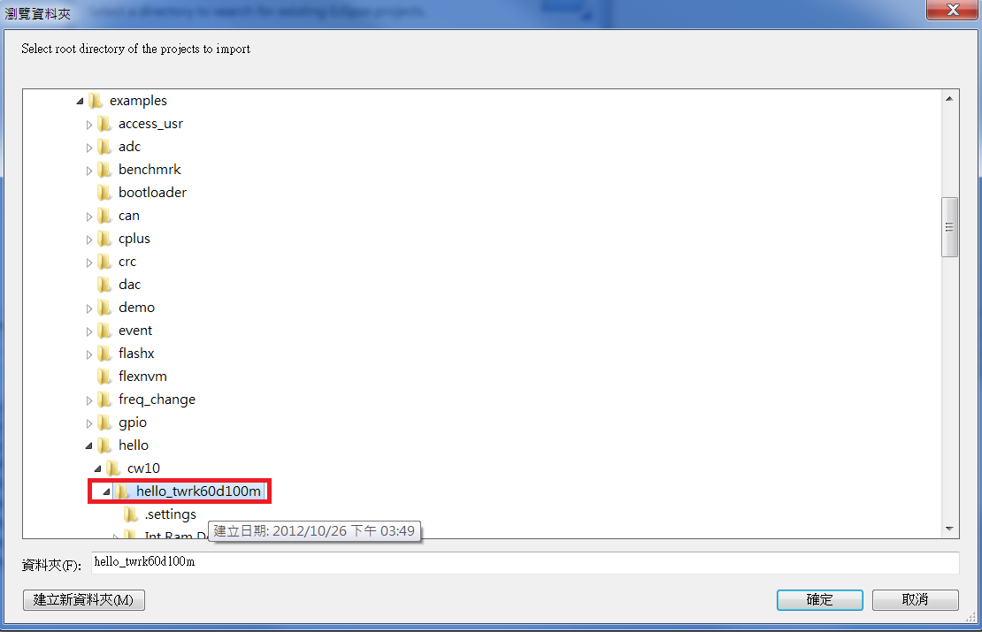
Basic Lab
Import the example project hello and load to the target board
Select menu File/Import/General/Existing Projects into Workspace and search for example directory (Freescale MQX 3.8 TWRK60D100M/mqx/examples/hello/cw10/hello_twrk60d100m).
1
2
Build the project hello_twrk60d100m
3
Debug the project hello_twrk60d100m

Slide 17
Basic
Download and install P&E OSBDM OSJTAG Virtual Serial Toolkit
Open P&E OSBDM OSJTAG Virtual Serial Toolkit → Utilities → Terminal Utility
Check following items: Port: USB COM Baud:115200 Parity:None Bits:8
Press “Open Serial Port”
Note : You can download toolkit from course FTP (final page)

Slide 18
Additional Explanations

Slide 19
Install Service Pack
When you install the development software in your computer, you may encounter a problem on building the library project.
You will see the warning message “Configuration error”
Make sure you install the Service Pack

Slide 20
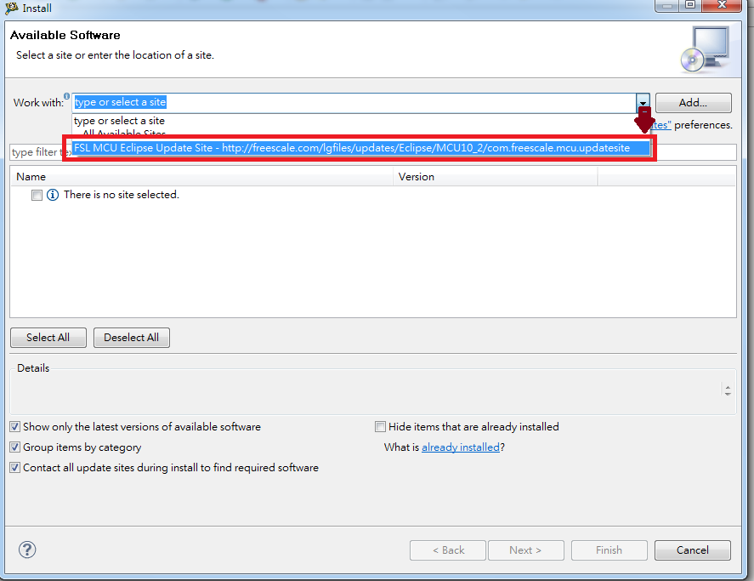
Install MCU 10.2 Service Pack for Kinetis k60d100m
1
2

Slide 21
Install MCU 10.2 Service Pack for Kinetis k60d100m
3
Select MCU v10 service pack for Kinetis 100MHz K60
Warning :
Do not select all Service Packs,
or you will spend a lot of time in the installation.

Slide 22
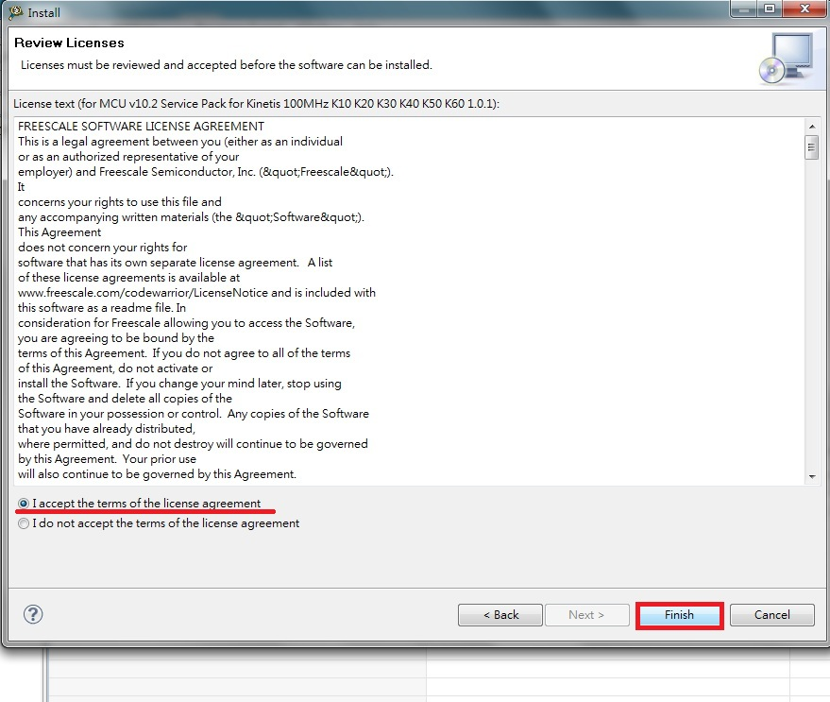
Install MCU 10.2 Service Pack for Kinetis k60d100m
4
5

Slide 23
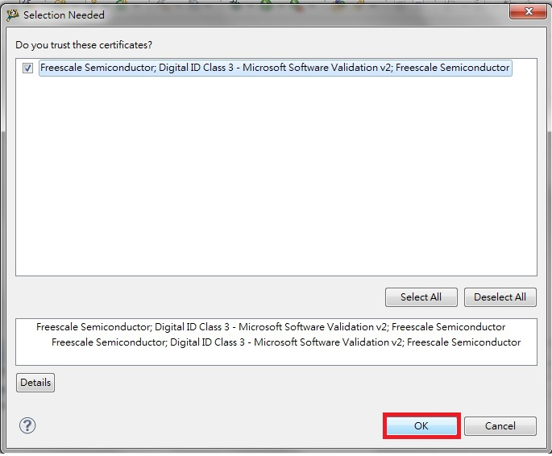
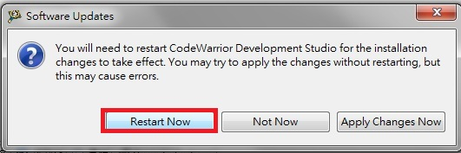
Install MCU 10.2 Service Pack for Kinetis k60d100m
6
7
8

Slide 24
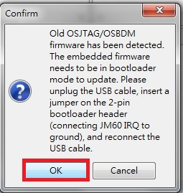
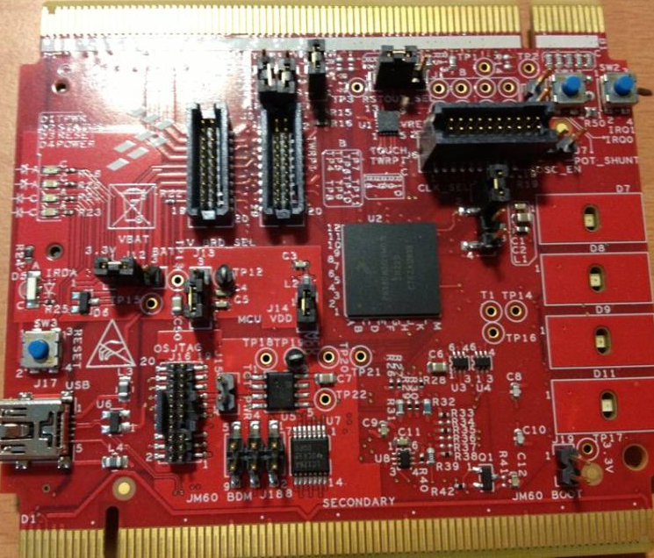
Update Firmware
When you first load a program to the Tower System, you need to update its firmware.
Press “Debug” button on codewarrior, and you will see
1
2
Unplug USB cable
Find an idle jumper and insert the 2-pin bootloader header
Reconnect USB cable
Press ”OK”
BOOT

Slide 25
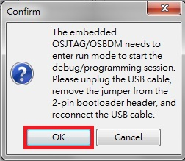
Update Firmware
2
Wait for the update of firmware
3
Unplug the USB cable
Remove the jumper from the 2-pin bootloader header
Reconnect the USB cable
Press “OK”

Slide 26
Download Software
FTP : 140.114.79.15
account： CS410100
Passwd ：emd
Download from : 環境安裝 / forTowerSystem
CW_MCU_v10.2_SE.exe
CodeWarrior v10.2
FSLMQX_3.8.0_TWRK60D100M.exe
MQX™ RTOS 3.8.0 TWR-K60D100M
pemicro_osbdm_osjtag_tower_toolkit
P&E OSBDM OSJTAG Virtual Serial Toolkit

