Slide 1
Principal Component Analysis (PCA)
2010 Scientific Computing
J.-S. Roger Jang (張智星)
CS Dept., Tsing Hua Univ., Taiwan
http://mirlab.org/jang
jang@mirlab.org
Notes:
...
In this talk, we are going to apply two neural network controller design techniques to fuzzy controllers, and construct the so-called on-line adaptive neuro-fuzzy controllers for nonlinear control systems. We are going to use MATLAB, SIMULINK and Handle Graphics to demonstrate the concept. So you can also get a preview of some of the features of the Fuzzy Logic Toolbox, or FLT, version 2.

Slide 2
Introduction
PCA (Principal Component Analysis)
An effective statistical method for reducing dataset dimensions while keeping spatial characteristics as much as possible
Applications
Image compression
Pattern recognition
Characteristics:
Designed for unlabeled data
A linear transformation with solid mathematical foundation
Easy to apply

Slide 3
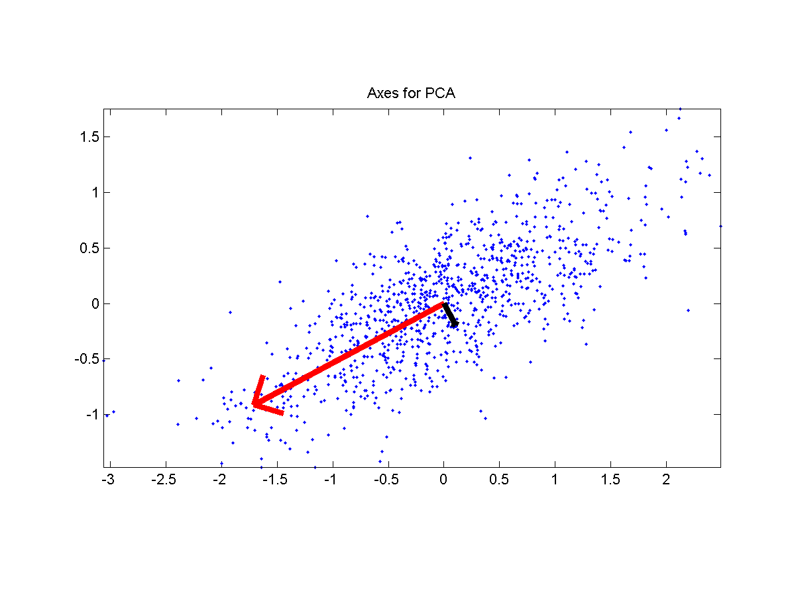
Problem Definition
Input
A dataset of n d-dim points which are zero justified
Output:
A unity vector u such that the square sum of the dataset’s projection onto u is maximized.

Slide 4
Math Formulation
Formulation
Dataset representation:
X is d by n, with n>d
Projection of each column of X onto u:
Square sum:
Objective function with a constraint on u:

Slide 5
Optimization of the Obj. Function
Optimization
Set the gradient to zero:
Implication:
u is the eigenvector while λ is the eigenvalue
When u is the eigenvector:
If we arrange eigenvalues such that:
Max of J(u) is λ1, which occurs at u=u1
Min of J(u) is λd, which occurs at u=ud

Slide 6
Steps for PCA
Find the sample mean:
Compute the covariance matrix:
Find the eigenvalues of C and arrange them into descending order, with the corresponding eigenvectors
The transformation is , with

Slide 7
Tidbits
PCA is designed for unlabeled data. For classification problem, we usually resort to LDA (linear discriminant analysis) for dimension reduction.
If d>>n, then we need to have a workaround for computing the eigenvectors

Slide 8
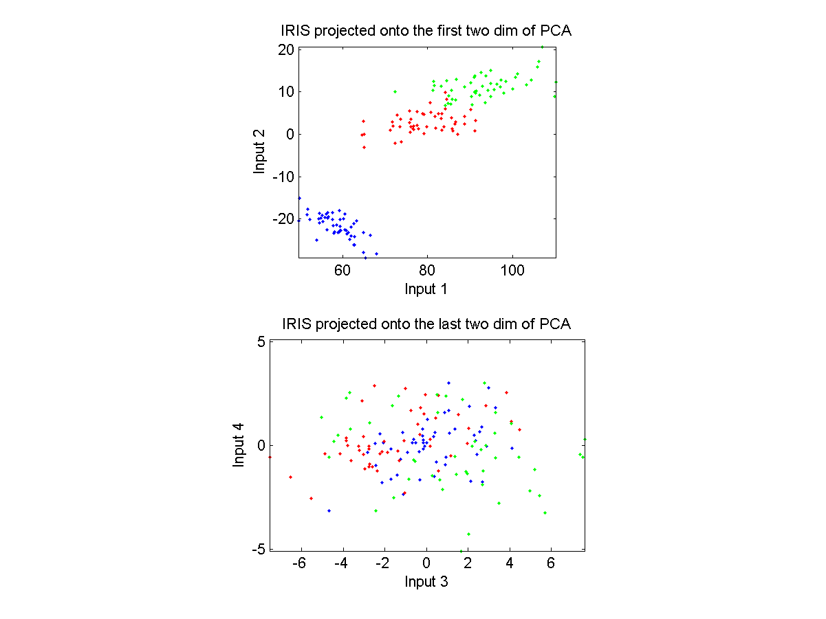
Example of PCA
IRIS dataset projection

Slide 9
Weakness of PCA
Not designed for classification problem (with labeled
training data.
Ideal situation
Adversary situation

Slide 10
Linear Discriminant Analysis
LDA projection onto directions that can best separate data
of different classes.
Adversary situation
for PCA
Ideal situation
for LDA

