Slide 1
Principal Component Analysis for Face Recognition
2010 Scientific Computing
J.-S. Roger Jang (張智星)
CS Dept., Tsing Hua Univ., Taiwan
http://mirlab.org/jang
jang@mirlab.org
Notes:
...
In this talk, we are going to apply two neural network controller design techniques to fuzzy controllers, and construct the so-called on-line adaptive neuro-fuzzy controllers for nonlinear control systems. We are going to use MATLAB, SIMULINK and Handle Graphics to demonstrate the concept. So you can also get a preview of some of the features of the Fuzzy Logic Toolbox, or FLT, version 2.

Slide 2
Face Recognition
Image database:
Test image:
A:
B:
Who is this guy?
C:
D:
Characteristics of FR:
A mode of biometric identification
Easy for human, hard for machine
E:
F:
G:

Slide 3
Biometric Identification
Identification of people from their physical characteristics, such as
faces
voices
fingerprints
palm prints
hand vein distributions
hand shapes and sizes
retinal scans

Slide 4
FR via PCA
First paper:
M. Turk and A. Pentland, "Eigenfaces for Recognition", Journal of Cognitive Neuroscience, vol. 3, no. 1, pp. 71-86, 1991
Characteristics
Efficient computation
Proven mathematics
Applicable to face detection

Slide 5
Problem Definition
Input
A dataset of face images of n person
An unknown person’s face image
Output:
Determine the identity of the unknown person

Slide 6
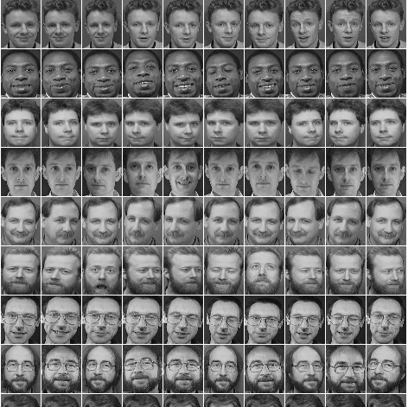
ATT Face Dataset
Origin
Olivetti Research Laboratory, 1992~1994
Stats:
40 subjects, each with 10 images
Characteristics
Same-size photos of black and white
Centered faces of different poses

Slide 7


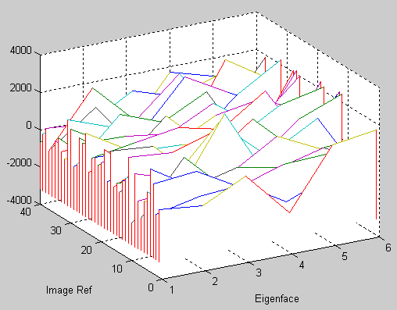

Face Recognition via PCA
Compute
Mean Face
Select 6
Principal
Eigenfaces
Facial Signatures
Compute
Eigenvectors
(Eigenfaces)
Subtract
400
400
400
Notes:
Quick step through the animation on this slide whilst talking about basic algorithm operation: calculate mean, subtract mean from all images, compute eigenvectors of entire image dataset (call these eigenfaces). These give the principal components that can be used to build up our images, in order of significance. To reduce the data we need to use, take the TOP 6. Based on these top 6, compute a set of signatures for the known faces. This last step is assisted with the formula to see how a face can be reconstructed.
Note where the big data is in this application. Note how we have to process all the images AT ONCE to derive optimum eigenvectors. However, in doing this processing we achieve great data reduction. As the number of faces in this database increases, the nunber of principal eigenfaces also increases, but not linearly. EG it is suggested in literature on this topic that only 100 eigenfaces are needed to be able to uniquely identify anybody.
Step to next slide to emphasise data set reduction

Slide 8
Steps of Feature Extraction via PCA
3 simple steps:
Data preprocessing
Each sample image is rearranged into a column vector of length 112*92=10304. All images are put into a matrix F of size 10304x400.
Mean face is subtracted from each column.
PCA
Find the eigenvectors of F*F’.
Projection
Select top k eigenvectors with k largest eigenvalues ➔ k eigenfaces!
Do projection along these eigenfaces to find new features for classification

Slide 9
Details for Step 2: PCA
Problem: is large,10304x10304! (849MB!) How to compute the eigenvectors of ?
Observation:
If u is the eigenvector of F’F, then Fu is the eigenvector of FF’.
If λ is the eigenvalue of F’F, then λ is also the eigenvalue of FF’.
Note that:
FF’ has 10304 eigenvalues.
F’F has 400 eigenvalues, corresponding to the 400 largest eigenvalues of FF’.

Slide 10
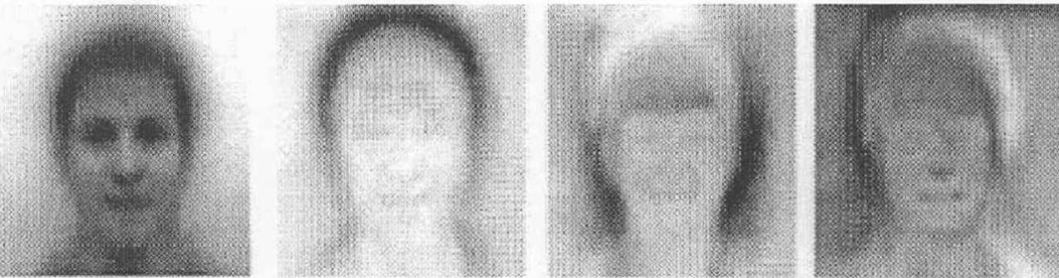
Details for Step 3: Projection (1/2)
Each face (minus the mean) in the training set can be represented as a linear combination of the best k eigenvectors:
Typical eigenfaces when k=4:

Slide 11
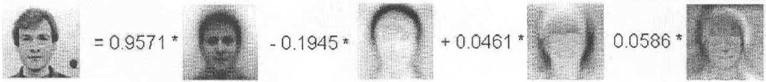
Details for Step 3: Projection (2/2)
Since is an orthonormal basis, any face (after mean subtraction) can be represented by this basis:
The feature vector of the face is then the new coordinates obtained by:

Slide 12
Classification
Once the features for images are extracted, we can then apply any classification methods to obtain the final recognition results, including
Minimum distance classifier
Support vector machines
Neural networks
Quadratic classifier
Gaussian mixture models

Slide 13
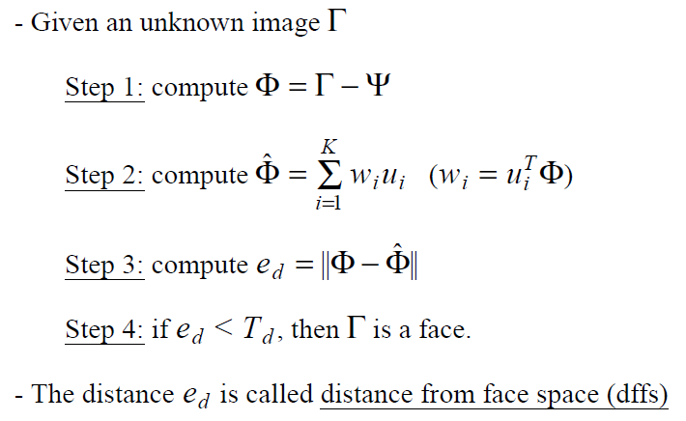
Face Detection Using Eigenfaces

Slide 14
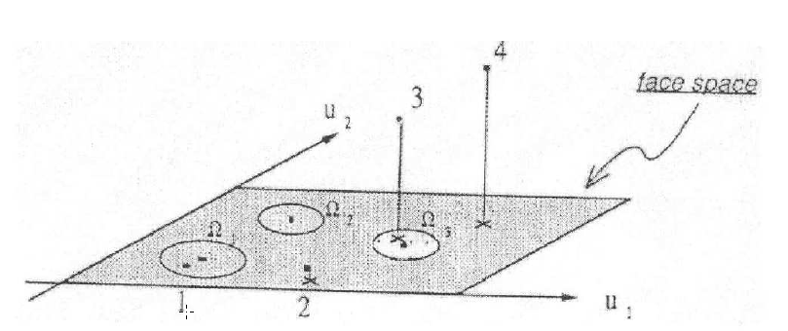
Distance from Face Space

