Slide 1
Introduction to Phonetics and Phonology
Yi-Wen Liu
EE6641: Analysis and Synthesis of Audio Signals
Revised Dec. 8, 2015

Slide 2
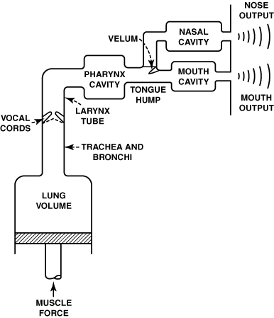
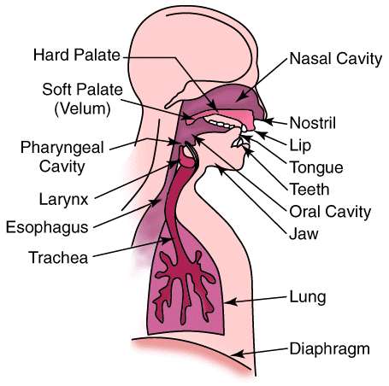
Speech production mechanisms

Slide 3
Linguistics
Phonetics: what are the sound building blocks?
Phonology: description of systems and patterns of sounds that occur in a language.
E.g., /ps/, /ts/ never precedes a vowel in English
E.g., ㄗ and ㄩ are never together in Mandarin
Syntax: from words to sentences
bufallo Bufallo bufallo bufallo bufallo Bufallo bufallo bufallo
[adj N Np v Np N Ns v]
“Colorless green ideas sleep furiously” ~Noam Chomsky
Semantics: what does it mean?
A: “he is truly an honest man.” B: “yea, right.”
“Time flies like an arrow.”
Fruit flies like a banana.

Slide 4

Syntax and semantics

Slide 5
Agenda
Articulatory phonetics
Places
Manners
Vowel production and accents
Allophones and phonemes
tones

Slide 6
Articulatory Phonetics
Vowels (母音, 元音) vs. Consonants (子音, 輔音)
Vowels:
steady flows, relatively unobstructed
Consonants:
constriction, occurring before or after vowels
Places of articulation
Manners of articulation

Slide 7
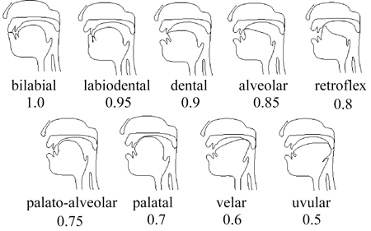
Places of articulation
雙唇音
唇齒音
齒音
齒齦音
捲舌音
Not shown:
pharyngeal
(咽音)
glottal
(聲門音)
顎齦音
硬顎音
軟顎音
小舌音

Slide 8
Manners of articulation
Vowel*
Approximant (“yes”, “way”)
Liquid (流音): “light”, “right [Am. Eng.]”
Fricative (擦音): f/v, s/z, etc.
Stop (塞音): t/d, p/b, k/g
Affricate (塞擦音): “ch”, “John”, ㄐㄑ ㄗㄘ ㄓㄔ
Nasality (鼻音化)

Slide 9
Manners of articulation not used in Mandarin or English
Trills (European and other languages)
Alveolar, uvular, even bilabial
Flap/tap
Clicks (“!” “|” “ʘ” in South Africa)
Double-stops (kp in Nigeria)
Nasal blow (Burma?)
Implosives (India?)

Slide 10
Example: the various ‘r’ sounds
Japanese: flap.
American English:
liquid before vowels
Rhoticized after a vowel, e.g. “bird”
British English “bird” is neutral
Only Mandarin and Am. Eng. have rhoticized ‘r’
Spanish: tap. “pero” (but)
‘rr’: trill; e.g., “perro” (dog)
Scottish/German: uvular trill.
French: uvular fricative “bon jour”, “train”

Slide 11
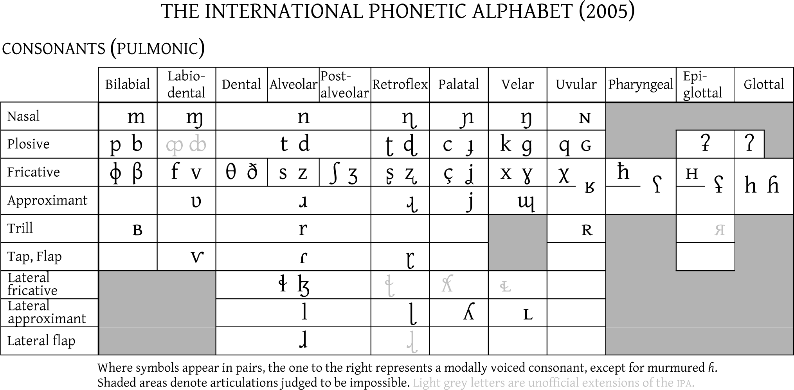
Consonants: IPA symbols
Notes: this chart does not contain Mandarin palato-alveolars (雞、七、希)

Slide 12
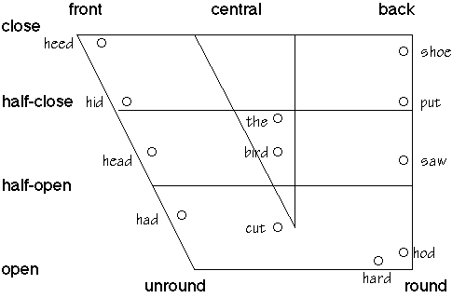
Articulation of vowels
Back vs. front
High/mid/low
Rounded vs. unrounded
The American English vowels

Slide 13
Rounded vs. unrounded lips
In American English, front vowels are unrounded, and back vowels rounded.
Except certain allophones (very “good”)
Not necessarily so in other languages
E.g., 魚 (fish), 鵝 (geese) in Mandarin
E.g., 16 vowels in French*

Slide 14
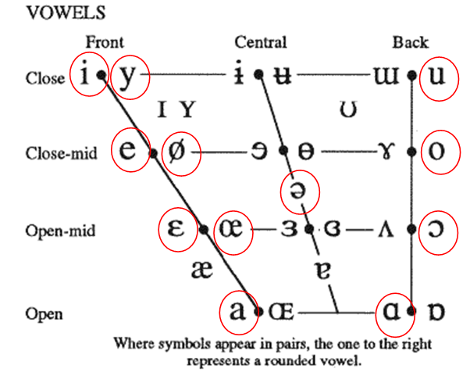
The International Phonetic Alphabet (IPA): vowels
Circles show the French vowels

Slide 15
Consonants: Stops
the voice-onset time (VOT).
voiced
un-voiced
0
common mis-conception
p: ㄅ
t: ㄉ
k: ㄍ
p^{h} : ㄆ
t^{h} : ㄊ
k^{h} : ㄎ
b
d g
b^{h}
d^{h}
g^{h}
Unaspirated
不送氣
Aspirated
送氣
Hindi has these!

Slide 16
Allophones and phonemes
When two articulations differentiate word meanings, they belong to different phonemes (音位).
When two similar articulations do not differentiate word meanings, they belong to the same phoneme in that language, and are called allophones (變體).

Slide 17
Example of allophones in consonants
e.g.: in English, un-aspirated stops occurs only after “s” (sport, stay, sky). They are complementary to the more frequent aspirated stops.
North-eastern China: “r” => “y”, 然後 vs. 延後
Wuhan, China: “n” and “l” are not differentiated. 喃喃 vs. 藍藍
Yunnan, China: “n” and “ng” are mixed. 船 vs. 床

Slide 18
Number of stop phonemes for each place of articulation
Hindi: 4
Taiwanese (閩南語), Thai: 3
*Korean: 3 (tense vs. soft)
English: 2, with allophones
Japanese, Spanish: 2, with allophones
Mandarin: 2, no allophones

Slide 19
No language has the complete set of all possible vowels
Mandarin does not differentiate
Taiwanese* back vowel: 蚵 (oyster) vs. 芋 (sweet taro)
Taiwanese nasalized vowels: 我 (me) vs. 碗 (bowl)
Taiwanese does not differentiate
high-front-unrounded vs. rounded vowels, e.g., 語 (speech) vs. 蟻 (ants) in Mandarin
Japanese has fewer vowels than many other languages
English does not differentiate long vs. short vowels as in Japanese
Some native American languages have a lot of short vowels…
Remark: “Taiwanese” refers to Southern-Min (閩南語) here.

Slide 20
Pronunciations are not stationary
They can change in time
due to socio-political influences?
The great vowel shift (15-17th century, Southern England).
[aː] (ā) fronted to [æː] and then raised to [ɛː], [eː] and in many dialects diphthongised to [eɪ] (as in make).
Middle English [ɛː] raised to [eː] and then to modern English [iː] (as in beak).
Middle English [eː] raised to Modern English [iː] (as in feet).
Middle English [iː] diphthongised to [ɪi], which was most likely followed by [əɪ] and finally Modern English [aɪ] (as in mice).
etc, e.g. “Knight”, “wrong”

Slide 21
as a world citizen
Never laugh at somebody’s accents, because he probably can pronounce what you can’t!

Slide 22
Why phonetics?
through the study of phonetics,
we become more sensitive to subtle articulatory differences.
we can learn to produce all of them.

Slide 23
Tonal languages: inflection differentiates word meanings
Include
All(?) Chinese languages, such as Mandarin, Taiwanese, Cantonese 粵語, Shanghai-nese 吳語, etc.
Vietnamese
Thai?
南腔 (accents) vs. 北調 (inflections) in Chinese local dialect/languages (why?)
Historical reason: invasions from the north since 2nd century B.C.
Geographical reason: plain in the north vs. mountains in the south

Slide 24
The Mandarin four tones
1st: 陰平
5
5
pitch
2nd: 陽平
4
4
3
3
2
2
1
3rd: 上聲
1
4th: 去聲
time

Slide 25

The Cantonese six tones
1st
壹 叁 柒
Sol
pitch
2nd: 玖
Fa
3rd: 肆 捌
5th: 伍
Mi
6th: 貳 陸
Do
4th: 零
It turns out that the number 0-9 covers all six tones plus three short tones.
time
Source of information = http://cantonese.ca/tones.php

Slide 26
Demo: Cantonese counting system
Cantonese distinguishes between high, middle and low tones, resulting in a more musical speech.
林子祥: The Counting Song (數字人生) http://www.youtube.com/watch?v=GrttavtmsRI

Slide 27
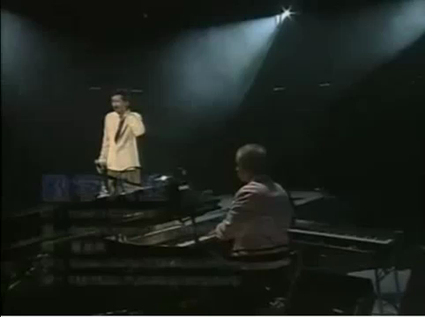

Slide 28
Tones in Taiwanese Southern-Min
It’s still debatable how many tones people use in Taiwanese Southern-Min language.
Common answers vary from 5 to 8.
Depending on whether short tones (入音) count as separate tones. e.g., /ba/ (肉) vs. /bak/ (目)
There might be local variations
Some argued there are 10 tones. [董忠司(2001)：台灣語入門，ISBN 957-32-4235-4]
Phonetically speaking, it’s questionable how many of these “tone candidates” actually differentiate word meanings.

Slide 29
References
P. Ladefoged (1993). “A course in phonetics,” 3rd edition, Orlando: Harcourt-Brace.
董忠司(2001)：台灣語語音入門，遠流出版社，ISBN 957-32-4235-4
林焘，耿振生 (1997)：聲韻學，三民書局，ISBN 957-14-2677-6
王小川：語音訊號處理，修訂二版，全華圖書 ISBN 978-957-21-6546-1

